Slide 1
Data-Intensive Scalable Computing in the Cloud
Lecture 4: RDBMS + Cloud

Slide 2
Today
Review
Homework 2 & 3 review
Lecture:
RDBMS Background
SQL vs. NoSQL (Ex: RDBMS vs. MapReduce)
RDB-as-a-Service
Demo: SQL Azure
Assignment:
Amazon RDS and MS SQL Azure

Slide 3
Review

Slide 4
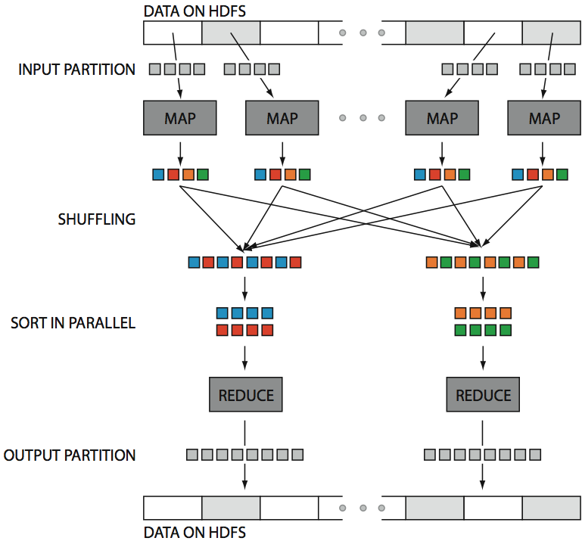
Hadoop in One Slide
src: Huy Vo, NYU Poly

Slide 5

Iterative Algorithms
Observation: MapReduce has proven successful as a common runtime for non-recursive declarative languages
HIVE (SQL)
Pig (RA with nested types)
Observation: Status quo is to roll your own loops
Graphs, clustering, mining, recursive queries
iteration managed by external script
Some
Thesis: With minimal extensions, we can provide an efficient common runtime for recursive languages
Map, Reduce, Fixpoint

Slide 6
Example 1: PageRank
Rank Table R₀
url | rank
www.a.com | 1.0
www.b.com | 1.0
www.c.com | 1.0
www.d.com | 1.0
www.e.com | 1.0
Linkage Table L
url_src | url_dest
www.a.com | www.b.com
www.a.com | www.c.com
www.c.com | www.a.com
www.e.com | www.c.com
www.d.com | www.b.com
www.c.com | www.e.com
www.e.com | www.c.om
www.a.com | www.d.com
R_{i+1}
π(url_dest, γ_{url_dest}SUM(rank))
R_{i}.rank = R_{i}.rank/γ_{url}COUNT(url_dest)
Rank Table R₃
url | rank
www.a.com | 2.13
www.b.com | 3.89
www.c.com | 2.60
www.d.com | 2.60
www.e.com | 2.13
R_{i}.url = L.url_src
R_{i}
L

Slide 7
A MapReduce Implementation
Join & compute rank
Aggregate
fixpoint evaluation
R_{i}
M
r
M
r
M
r
L-split0
M
r
M
r
M
r
L-split1
M
i=i+1
Converged?
Client
done

Slide 8
What’s the problem?
R_{i}
m
r
M
r
M
r
L-split0
m
r
M
r
M
r
L-split1
3.
m
2.
1.
L is loop invariant, but
L is loaded on each iteration
L is shuffled on each iteration
Fixpoint evaluated as a separate MapReduce job per iteration
plus

Slide 9
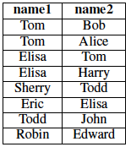
Example 2: Transitive Closure
Friend
Find all transitive friends of Eric
R₀
{Eric, Eric}
R₁
{Eric, Elisa}
R₂
{Eric, Tom
Eric, Harry}
R₃
{}
(semi-naïve evaluation)

Slide 10
Example 2 in MapReduce
(compute next generation of friends)
Join
(remove the ones we’ve already seen)
Dupe-elim
S_{i}
M
r
M
r
Friend0
M
r
M
r
Friend1
M
Anything new?
i=i+1
Client
done

Slide 11
What’s the problem?
(compute next generation of friends)
Join
(remove the ones we’ve already seen)
Dupe-elim
S_{i}
M
r
M
r
Friend0
M
r
M
r
Friend1
M
2.
1.
Friend is loop invariant, but
Friend is loaded on each iteration
Friend is shuffled on each iteration

Slide 12
Example 3: k-means
k_{i}
= k centroids at iteration i
k_{i}
P0
M
r
k_{i}
P1
M
k_{i+1}
r
k_{i}
P2
M
k_{i} - k_{i+1} < threshold?
Client
i=i+1
done

Slide 13
What’s the problem?
k_{i}
k_{i}
= k centroids at iteration i
P0
M
r
k_{i}
P1
M
k_{i+1}
r
k_{i}
P2
M
1.
k_{i} - k_{i+1} < threshold?
Client
i=i+1
done
P is loop invariant, but
P is loaded on each iteration

Slide 14
Approach: Inter-iteration caching
Loop body
M
…
r
M
r
M
Reducer output cache (RO)
Reducer input cache (RI)
Mapper output cache (MO)
Mapper input cache (MI)

Slide 15
RI: Reducer Input Cache
Provides:
Access to loop invariant data without map/shuffle
Used By:
Reducer function
Assumes:
Mapper output for a given table constant across iterations
Static partitioning (implies: no new nodes)
PageRank
Avoid shuffling the network at every step
Transitive Closure
Avoid shuffling the graph at every step
K-means
No help
…

Slide 16
Reducer Input Cache Benefit
Transitive Closure
Billion Triples Dataset (120GB)
90 small instances on EC2
Overall run time

Slide 17
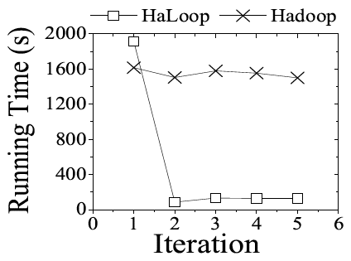
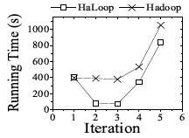
Reducer Input Cache Benefit
Transitive Closure
Billion Triples Dataset (120GB)
90 small instances on EC2
Livejournal, 12GB
Join step only

Slide 18
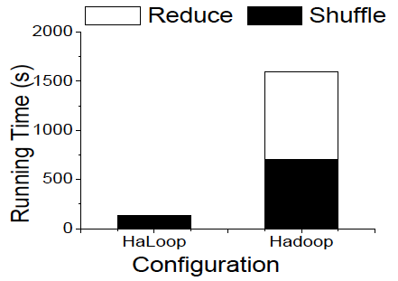
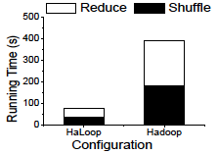
Reducer Input Cache Benefit
Transitive Closure
Billion Triples Dataset (120GB)
90 small instances on EC2
Livejournal, 12GB
Reduce and Shuffle of Join Step

Slide 19
HaLoop [Bu 2010, Bu 2012]
Join & compute rank
Aggregate
fixpoint evaluation
R_{i}
M
r
M
r
M
r
L-split0
M
r
M
r
M
r
L-split1
M
Total

Slide 20
Homework Review

Slide 21
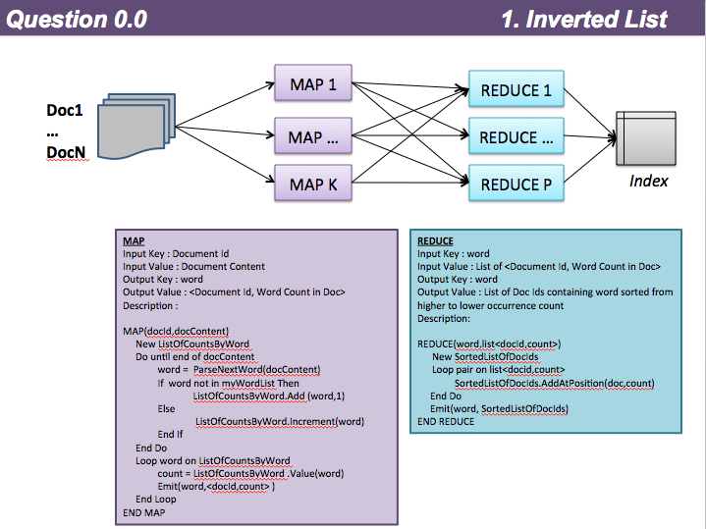

Slide 22
Social Network
Map:
Input Key: Datafile Name
Input Value: Datafile Contents (A list of relationships (person -> friend))
Output Key: Person
Output Value: 1
Description: This is very similar to the word count example; essentially it’s just mapping a person to a number that can later be summed. If the data file format is <Person,Friend> then it’s just a matter of replacing all the Friend values with ‘1’.
Reduce:
Input Key: Person
Input Value: 1
Output Key: Person
Output Value: Total (Sum of input values)
Description: This simply adds all the values for a Person (the unique key).

Slide 23
Relational Join Example
Order:
101, Raj, 3333, 99.99
201, Bill, 4444, 49.99
LineItem:
1, 101, Android Tablet, shipped
2, 101, tablet cover, processing
1, 201, book, processing
2, 201,CD, processing
In this scenario 101 and 201 are the Group_Keys. Tagging, shuffling and sorting will happen prior to the Reducer() Tasks in the Mapper () tasks
(Key: 101) {Value- Tag: Order 101, Raj, 3333, 99.99 )
(Key: 101) {Value- Tag: LineItem 1, 101, Android Tablet, shipped)
(Key: 201) {Value- Tag: Order 201, Bill, 4444, 49.99)
(Key: 201) {Value- Tag: LineItem 1, 201, book, processing)

Slide 24
Relation Join, again
Input Key: table-name
Input Value: record
Output Key: order_id
Output Value: pair(table-name, record)
Input Key: order_id
Input Value: table-name-record-list
Output Key: order_id
Output Value: record

Slide 25
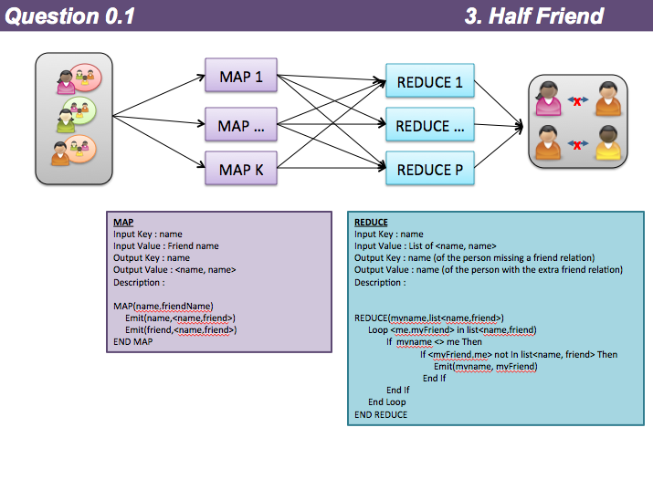

Slide 26
Bioinformatics
Map:
Input Key: sequence-id
Input Value: sequence
Output Key: truncated-sequence
Output Value: 1 // not used
Description: Truncate each sequence
Reduce:
Input Key: truncated-sequence
Input Value: list // not used
Output Key: truncated-sequence
Output Value: 1 // not used
Description: just emit the key

Slide 27
RDBMS and Cloud computing

Slide 28
Roadmap
RDBMS history
RDBMS vs. MapReduce
Pavlo 2009
DB-as-a-Service
SQL Azure
Amazon RDS
Query-as-a-Service
Fusion Tables
SQLShare
Next 2 weeks: NoSQL, key-value stores

Slide 29
Roadmap
RDBMS history
RDBMS vs. MapReduce
Pavlo 2009
DB-as-a-Service
SQL Azure
Amazon RDS
Query-as-a-Service
Fusion Tables
SQLShare
Next 2 weeks: NoSQL, key-value stores

Slide 30
Relational Database History
Pre-Relational: if your data changed, your application broke.
Early RDBMS were buggy and slow (and often reviled), but required only 5% of the application code.
“Activities of users at terminals and most application programs should remain unaffected when the internal representation of data is changed and even when some aspects of the external representation are changed.”
-- Codd 1979
Key Ideas: Programs that manipulate tabular data exhibit an algebraic structure allowing reasoning and manipulation independently of physical data representation
Notes:
It provides a means of describing data with its natural structure only--that is, without superimposing any additional structure for machine representation purposes. Accordingly, it provides a basis for a high level data language which will yield maximal independence between programs on the one hand and machine representation on the other.

Slide 31
Key Idea: Data Independence
SELECT *
FROM my_sequences
views
logical data independence
SELECT seq
FROM ncbi_sequences
WHERE seq = ‘GATTACGATATTA’;
relations
physical data independence
f = fopen(‘table_file’);
fseek(10030440);
while (True) {
fread(&buf, 1, 8192, f);
if (buf == GATTACGATATTA) {
. . .
files and pointers

Slide 32
Key Idea: Indexes
Databases are especially, but not exclusively, effective at “Needle in Haystack” problems:
Extracting small results from big datasets
Transparently provide “old style” scalability
Your query will always* finish, regardless of dataset size.
Indexes are easily built and automatically used when appropriate
CREATE INDEX seq_idx ON sequence(seq);
SELECT seq
FROM sequence
WHERE seq = ‘GATTACGATATTA’;
*almost

Slide 33
Key Idea: An Algebra of Tables
select
project
join
join
Other operators: aggregate, union, difference, cross product
Notes:
It turns out that you can express a wide variety of computations using only a handful of operators.

Slide 34
Key Idea: Algebraic Optimization
N = ((z*2)+((z*3)+0))/1
Algebraic Laws:
1. (+) identity: x+0 = x
2. (/) identity: x/1 = x
3. (*) distributes: (n*x+n*y) = n*(x+y)
4. (*) commutes: x*y = y*x
Apply rules 1, 3, 4, 2:
N = (2+3)*z
two operations instead of five, no division operator
Same idea works with the Relational Algebra!

Slide 35
Key Idea: Declarative Languages
Find all orders from today, along with the items ordered
SELECT *
FROM Order o, Item i
WHERE o.item = i.item
AND o.date = today()
join
o.item = i.item
select
date = today()
scan
scan
Item i
Order o

Slide 36
Shared Nothing Parallel Databases
Teradata
Greenplum
Netezza
Aster Data Systems
Datallegro
Vertica
MonetDB
Microsoft
Recently commercialized as “Vectorwise”

Slide 37
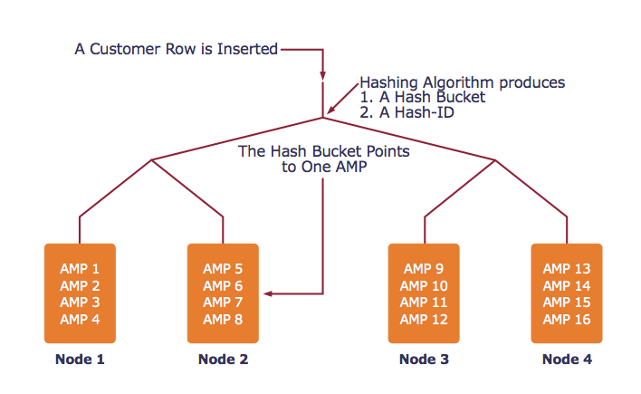
Example System: Teradata
AMP = unit of parallelism

Slide 38
Example System: Teradata
Find all orders from today, along with the items ordered
SELECT *
FROM Orders o, Lines i
WHERE o.item = i.item
AND o.date = today()
join
o.item = i.item
select
date = today()
scan
scan
Item i
Order o

Slide 39
Example System: Teradata
AMP 4
AMP 5
AMP 6
hash
hash
hash
h(item)
h(item)
h(item)
select
select
select
date=today()
date=today()
date=today()
scan
scan
scan
Order o
Order o
Order o
AMP 1
AMP 2
AMP 3

Slide 40
Example System: Teradata
AMP 4
AMP 5
AMP 6
hash
hash
hash
h(item)
h(item)
h(item)
scan
scan
scan
Item i
Item i
Item i
AMP 1
AMP 2
AMP 3

Slide 41
Example System: Teradata
join
join
join
o.item = i.item
o.item = i.item
o.item = i.item
AMP 4
AMP 5
AMP 6
contains all orders and all lines where hash(item) = 3
contains all orders and all lines where hash(item) = 2
contains all orders and all lines where hash(item) = 1

Slide 42
MapReduce Contemporaries
Dryad (Microsoft)
Relational Algebra
Pig (Yahoo)
Near Relational Algebra over MapReduce
HIVE (Facebook)
SQL over MapReduce
Cascading
Relational Algebra
Clustera
U of Wisconsin
Hbase
Indexing on HDFS

Slide 43
MapReduce vs RDBMS
RDBMS
Declarative query languages
Schemas
Logical Data Independence
Indexing
Algebraic Optimization
Caching/Materialized Views
ACID/Transactions
MapReduce
High Scalability
Fault-tolerance
“One-person deployment”
DryadLINQ, Pig, HIVE
HIVE, Pig, DryadLINQ
Hbase
Pig, (Dryad, HIVE)

Slide 44
Comparison
 | Data Model | Prog. Model | Services
GPL | * | * | Typing (maybe)
Workflow | * | dataflow | typing, provenance, scheduling, caching, task parallelism, reuse
Relational Algebra | Relations | Select, Project, Join, Aggregate, … | optimization, physical data independence, data parallelism
MapReduce | [(key,value)] | Map, Reduce | massive data parallelism, fault tolerance
MS Dryad | IQueryable, IEnumerable | RA + Apply + Partitioning | typing, massive data parallelism, fault tolerance
MPI | Arrays/ Matrices | 70+ ops | data parallelism, full control

Slide 45
Roadmap
RDBMS history
RDBMS vs. MapReduce
Pavlo 2009
DB-as-a-Service
SQL Azure
Amazon RDS
Query-as-a-Service
Fusion Tables
SQLShare
Next 2 weeks: NoSQL, key-value stores

Slide 46
Hadoop vs. RDBMS
Pavlo et al. 2009
Comparison of 3 systems
Hadoop
Vertica (a column-oriented database)
DBMS-X (a row-oriented database)
rhymes with “schmoracle”
Qualitative
Programming model, ease of setup, features, etc.
Quantitative
Data loading, different types of queries

Slide 47
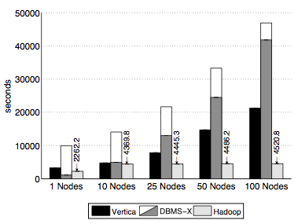
Load Times
20GB / node

Slide 48
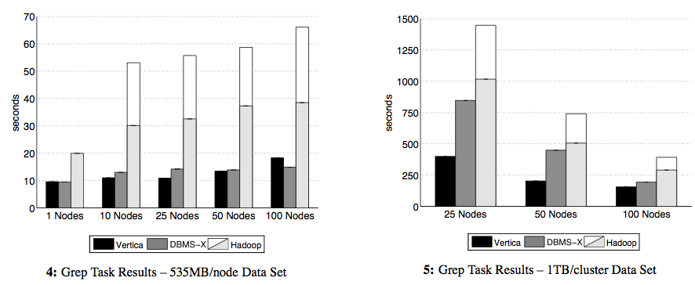
Grep-like Task
SELECT * FROM Data WHERE field LIKE ‘%XYZ%’

Slide 49
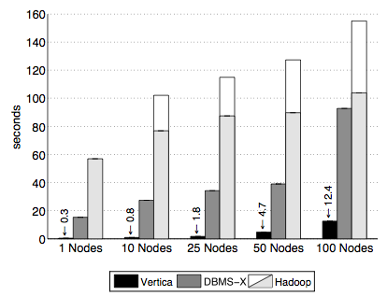
Selection Task
SELECT pageURL, pageRank
FROM Rankings WHERE pageRank > X
1 GB / node

Slide 50
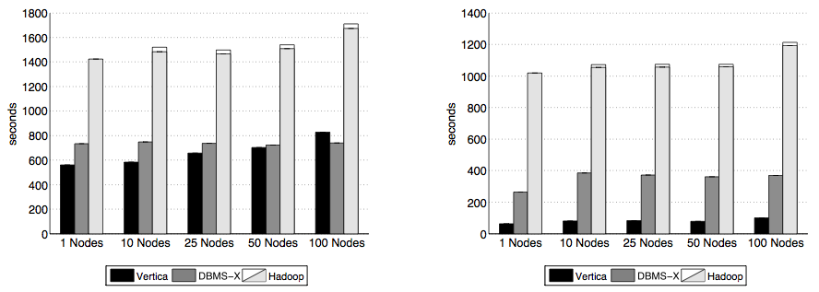
Aggregation Task
SELECT SUBSTR(sourceIP,1, 7), SUM(adRevenue)
FROM UserVisits
GROUP BY SUBSTR(sourceIP,1, 7);

Slide 51
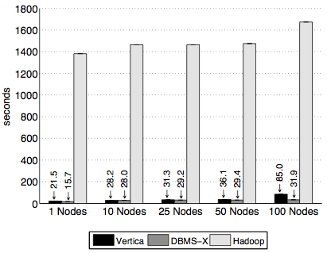
Join Task
SELECT INTO TempsourceIP,
AVG(pageRank)as avgPageRank,
SUM(adRevenue)as totalRevenue
FROM RankingsAS R
, UserVisitsAS UV
WHERE R.pageURL = UV.destURL
AND UV.visitDate
BETWEEN ‘2000-01-15’
AND ‘2000-01-22’
GROUP BY UV.sourceIP;
SELECT sourceIP,
totalRevenue,
avgPageRank
FROM Temp
ORDER BY totalRevenueDESC
LIMIT 1;

Slide 52
Roadmap
RDBMS history
RDBMS vs. MapReduce
Pavlo 2009
DB-as-a-Service
SQL Azure
Amazon RDS
Query-as-a-Service
Fusion Tables
SQLShare
Next 2 weeks: NoSQL, key-value stores

Slide 53
Current DBaaS offerings
Mostly hosted off-the-shelf databases
Amazon RDS: MySQL, Oracle, and soon SQL Server
Microsoft SQL Azure: SQL Server (not quite identical)
Database.com: Oracle
Some convenience features
multi-zone availability
automatic backup
As of yet, no full SQL, fully parallel database services
stay tuned to the RelationalCloud project at MIT
Issues to consider as a designer:
multi-tenancy, privacy, scale-out
Issues to consider as a user:
performance, reliability, predictability

Slide 54
Roadmap
RDBMS history
RDBMS vs. MapReduce
Pavlo 2009
DB-as-a-Service
SQL Azure
Amazon RDS
Query-as-a-Service
Fusion Tables
SQLShare
Next 2 weeks: NoSQL, key-value stores

Slide 55


Database-as-a-Service For the 99%

Slide 56
Problem
How much time do you spend “handling data” as opposed to “doing science”?
Mode answer:
“90%”
Notes:
(granted we had a minute for Bill (clearly Bill) to describe this new eScience movement)
We want to give a little background of our project before we launch into it, so we will discuss the problem we are trying to solve.
Essentially, we want to remove the speed-bump of data handling from the scientists.

Slide 57
Simple Example
ANNOTATIONSUMMARY-COMBINEDORFANNOTATION16_Phaeo_genome
COGAnnotation_coastal_sample.txt
SELECT * FROM Phaeo_genome p, coastal_sample c WHERE p.COG_hit = c.hit
Notes:
Previously, researchers had to manually cross-reference data between spreadsheets.
We’ve heard that this process in particular could take a week to do depending on the number of data sources.
But as common database users, we recognize that the join between these datasets is trivially expressed in SQL

Slide 58
Which samples have not been cloned?
SELECT *
FROM plasmiddb
WHERE NOT (ISDATE(cloned) OR cloned = ‘yes’)

Slide 59
Find all TIGRFam ids (proteins) that are missing from at least one of three samples (relations)
SELECT col0 FROM [refseq_hma_fasta_TGIRfam_refs]
UNION
SELECT col0 FROM [est_hma_fasta_TGIRfam_refs]
UNION
SELECT col0 FROM [combo_hma_fasta_TGIRfam_refs]
EXCEPT
SELECT col0 FROM [refseq_hma_fasta_TGIRfam_refs]
INTERSECT
SELECT col0 FROM [est_hma_fasta_TGIRfam_refs]
INTERSECT
SELECT col0 FROM [combo_hma_fasta_TGIRfam_refs]

Slide 60
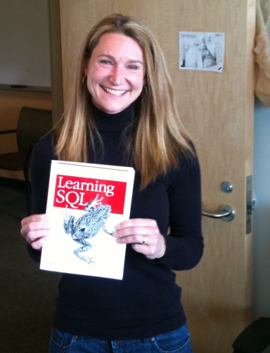
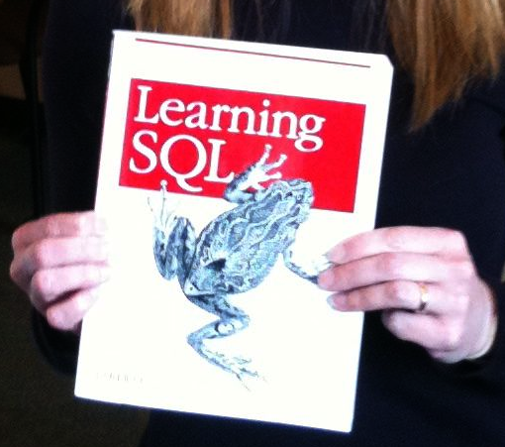
What’s the point?
Databases are underused by the 99%
Conventional wisdom (and the conventional proposal reviewer) says “Scientists won’t write SQL”
This is utter horseshit
We corroborate findings by SDSS, etc.
Instead, we implicate difficulty in
installation
configuration
schema design
performance tuning
data loading
app-building (over-reliance on GUIs)
We ask instead, “What kind of platform can support ad hoc scientific Q&A with SQL?”

Slide 61
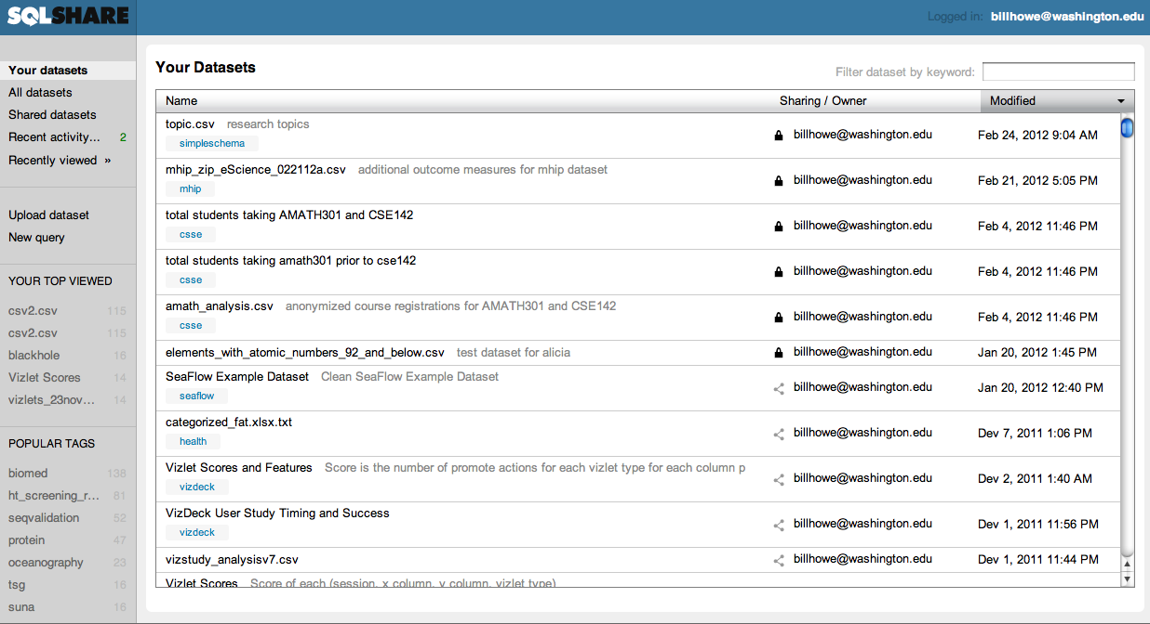
http://sqlshare.escience.washington.edu

Slide 62
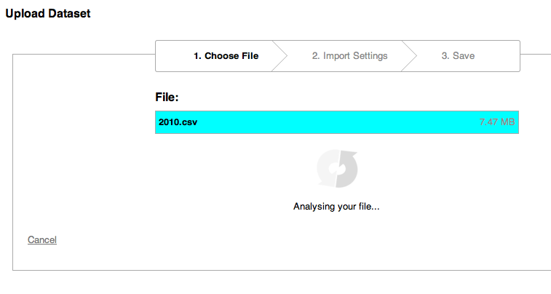
http://sqlshare.escience.washington.edu

Slide 63
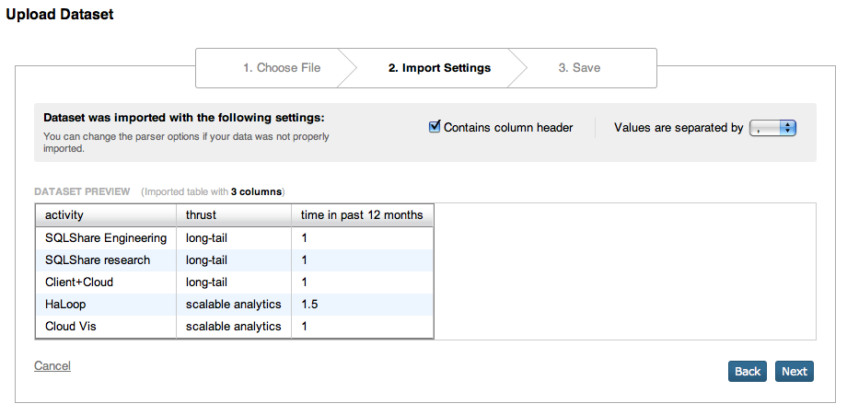
http://sqlshare.escience.washington.edu

Slide 64
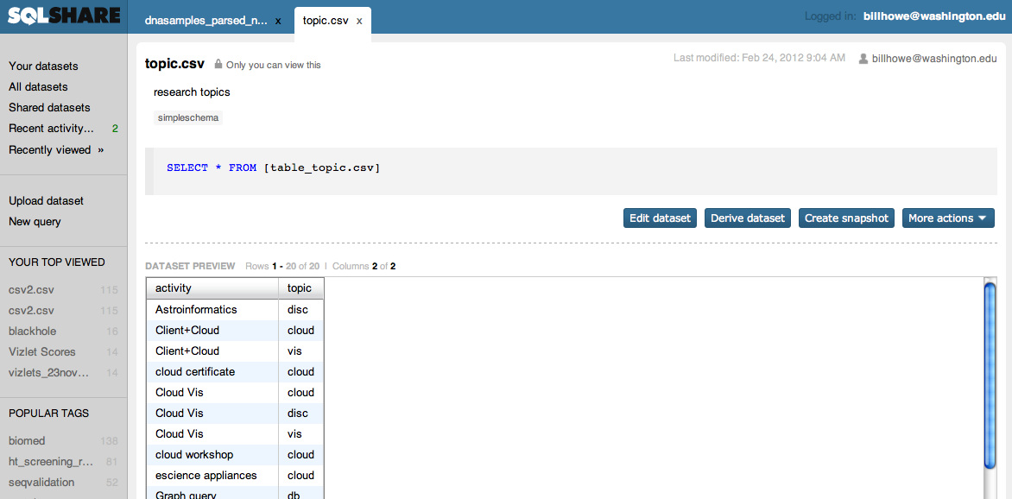
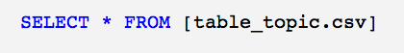
http://sqlshare.escience.washington.edu

Slide 65
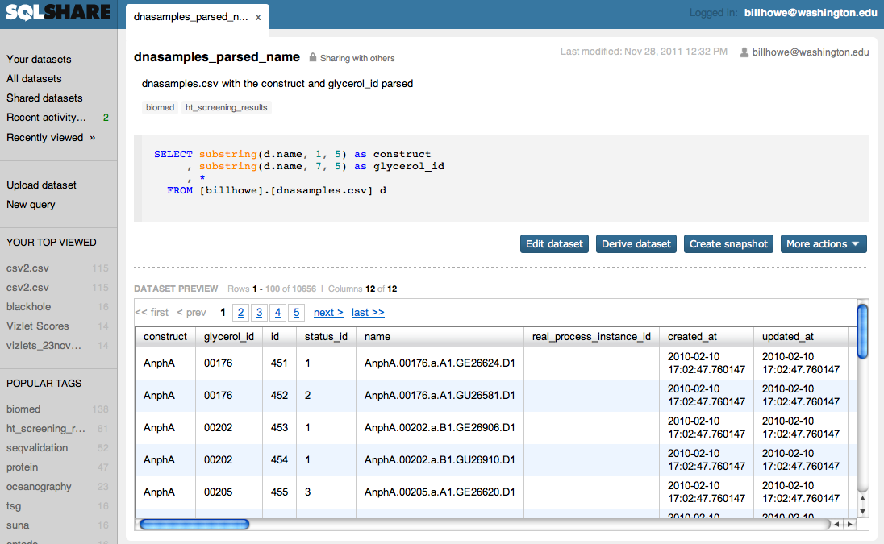
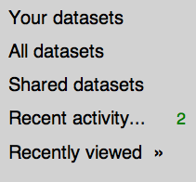
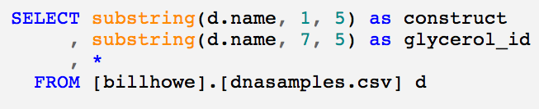
http://sqlshare.escience.washington.edu

Slide 66
Details
Backend is Microsoft’s SQL Azure
About a year old, essentially zero advertising
50+ active users (UW and external)
2500+ tables/views (~20% are public
largest table: 1.1M rows, smallest table: 1 row
transitioning to support by UW-IT

Slide 67
View Semantics and Features
“Saved query” = View with attached metadata
Unify views and tables as “datasets”
table = “select * from [raw_table]”
Replacement semantics for name conflicts
old versions materialized and archived
Materialize downstream views
when dependencies deleted
when dependencies become incompatible
Permissions
public, private, ACLs (may work on groups in the future)
Sharing, social querying, CQMS*
search, recent queries, friends’ queries, favorites, ratings
facilitate sharing and recommendations of not just whole queries, but common predicates, join patterns, etc.
* [Khoussainova, CIDR 2009]

Slide 68
SQLShare as a Research Platform
SQL Autocomplete
(Nodira Khoussainova, YongChul Kwon, Magda Balazinska)
English to SQL
(Bill Howe, Luke Zettlemoyer, Emad Soroush, Paras Koutris)
Automatic “Starter” Queries
(Bill Howe, Garret Cole, Nodira Khoussainova, Leilani Battle)
VizDeck: Automatic Mashups and Visualization
(Bill Howe, Alicia Key)
Personalized Query Recommendation
(Yuan Zhou, Bill Howe)
Info Extraction from Spreadsheets
(Mike Cafarella, Dave Maier, Bill Howe)
Differential Privacy in Multi-tenant DBs
(Dan Suciu, Bill Howe)
SSDBM 2011
SIGMOD 2011 (demo)
SSDBM 2011
CHI 2012
SIGMOD 2012 (demo)

Slide 69

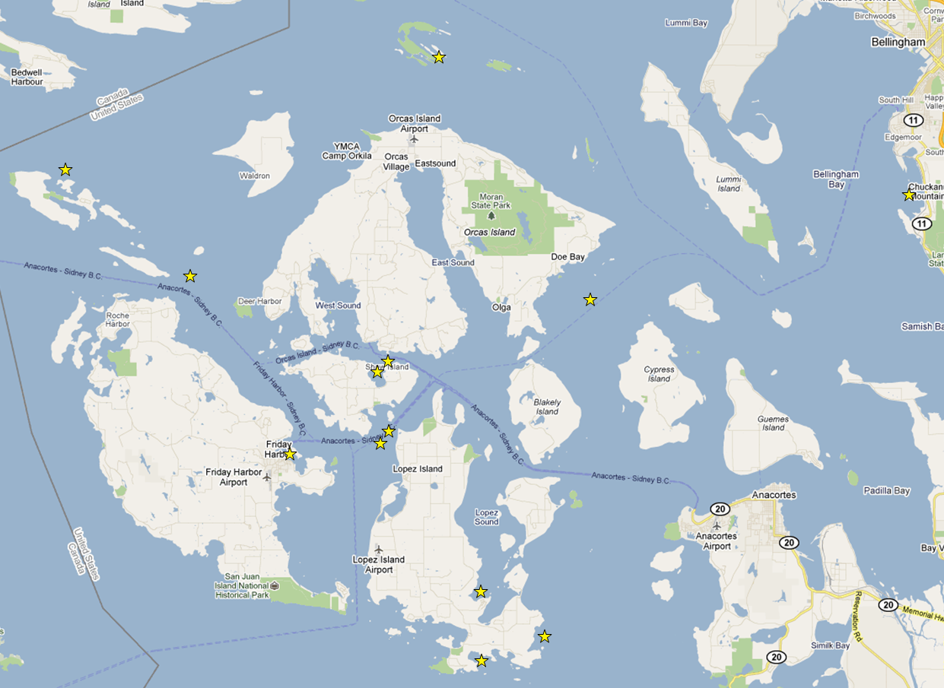

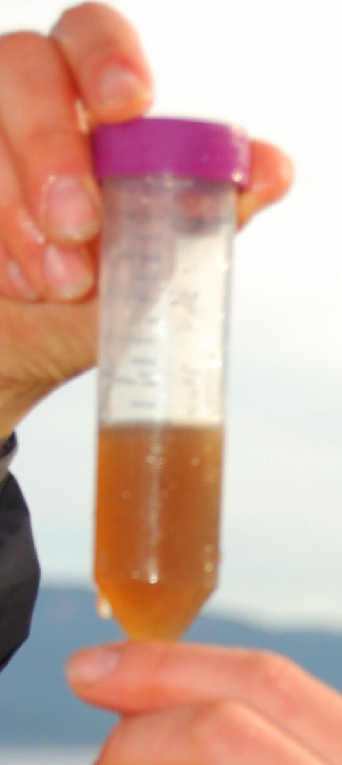
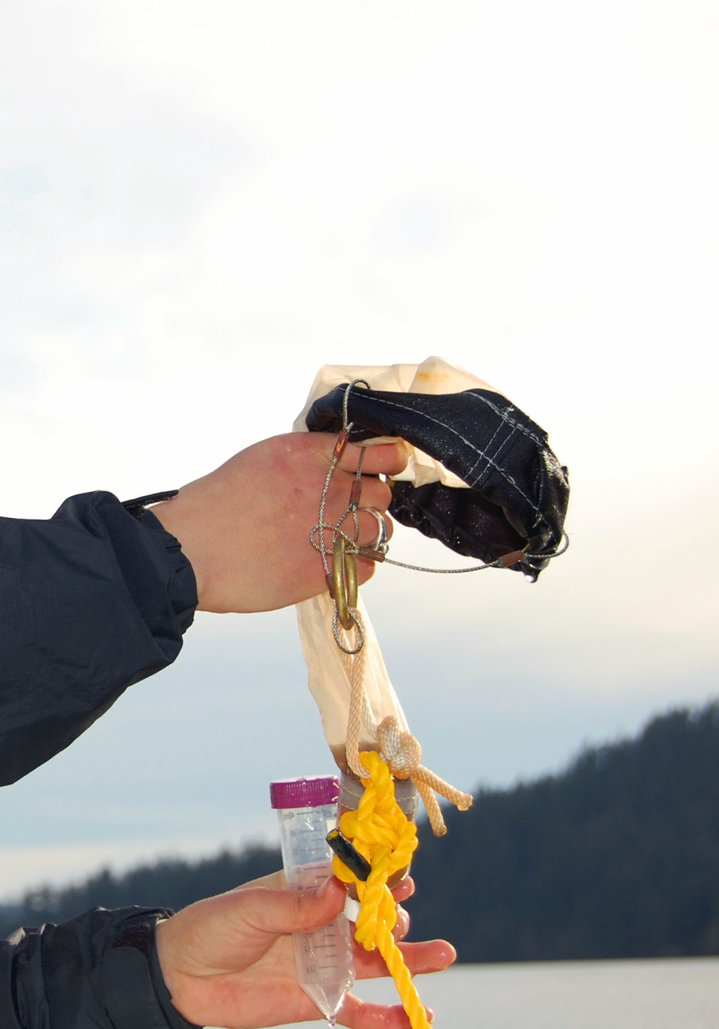
2010 Pilot- Outreach and Education-based sampling: Schooner Adventuress
Robin Kodner
9
13
11
14
12
15
16
10
4
5
8
7
6

Slide 70
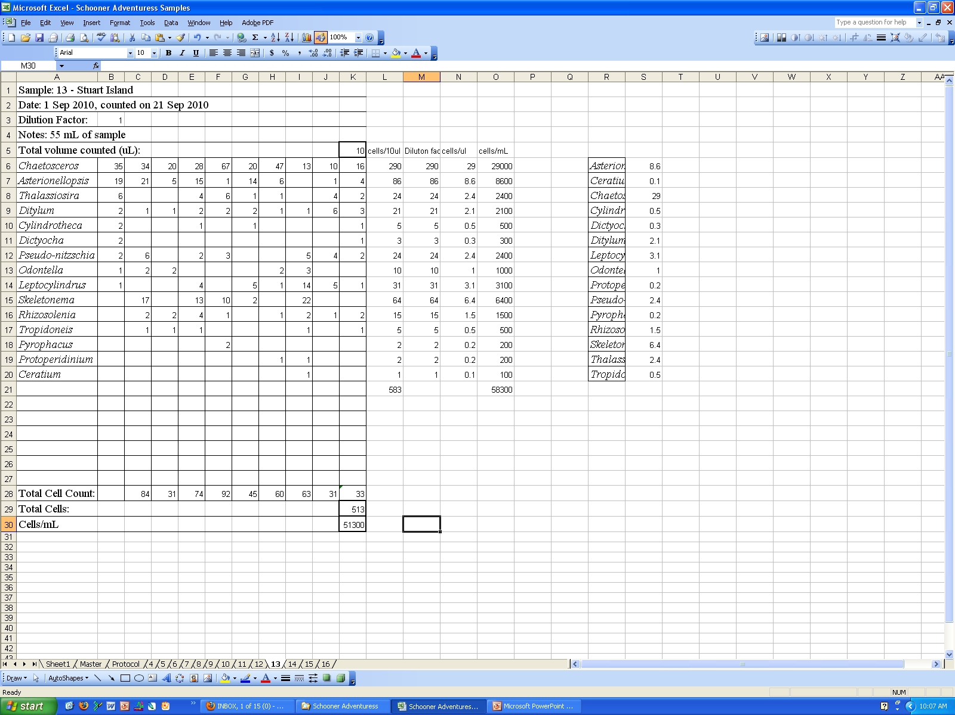
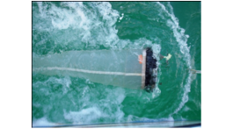
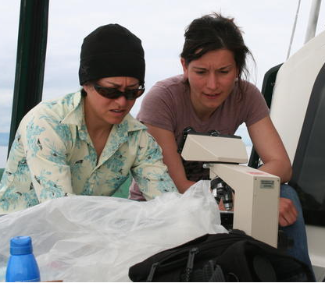
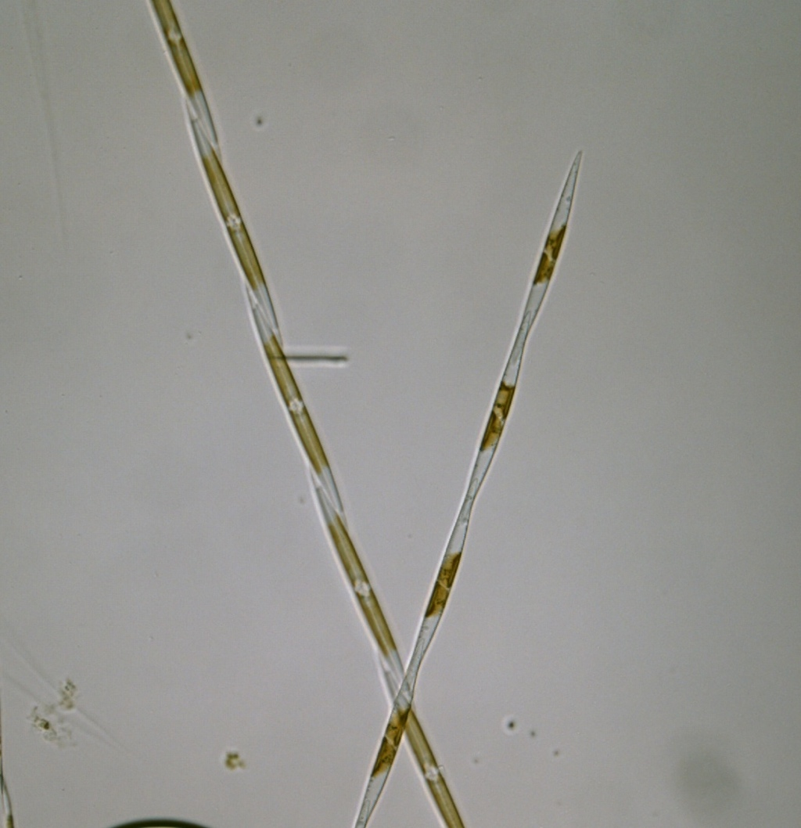
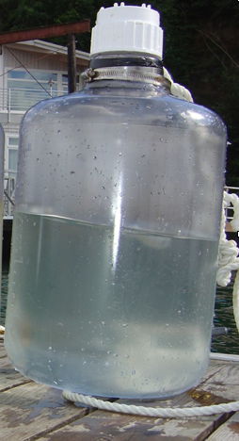
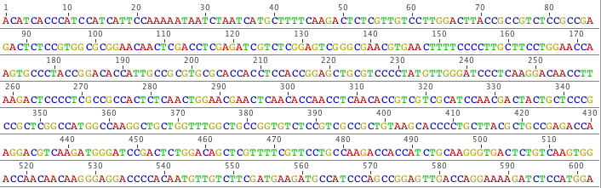
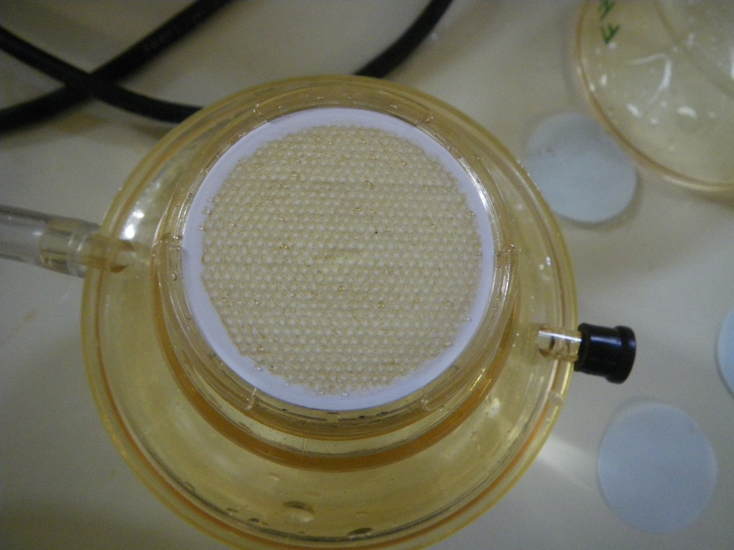
plankton tows
taxa counts
whole water
DNA/RNA
sequencing
nutrient analysis + toxin analysis

Slide 71

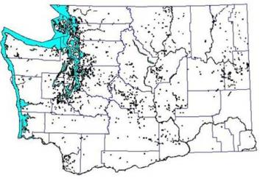
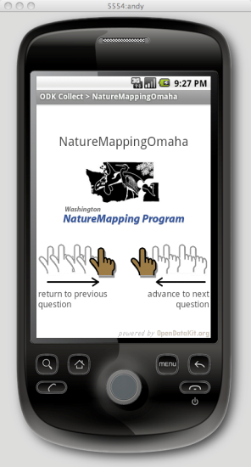
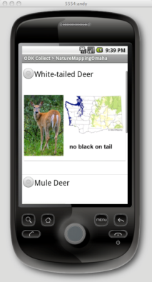
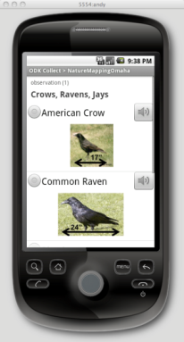
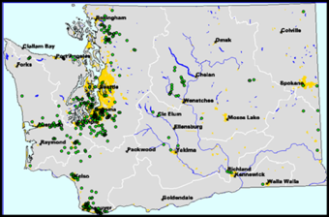
NatureMapping Program
Karen Dvornich
Wildlife Observations (1902- )
Data collection and submission options:
Download/upload spreadsheet
Online data entry
NatureTracker on handheld/GPS
Android ODK (Open Data Kit)
Water Quality Monitoring Sites (2003 - )

Slide 72
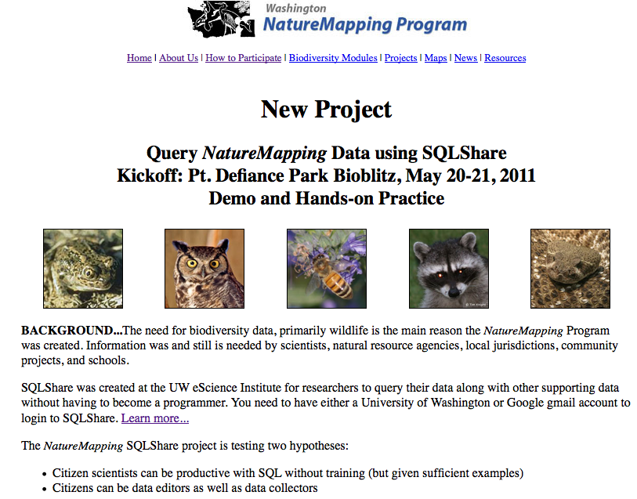
Karen Dvornich

Slide 73
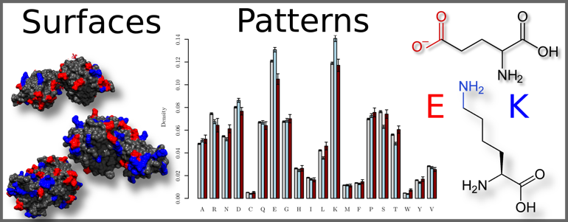
Andrew White, UW Chemistry
“An undergraduate student and I are working with gigabytes of tabular data derived from analysis of protein surfaces.
Previously, we were using huge directory trees and plain text files.
Now we can accomplish a 10 minute 100 line script in 1 line of SQL.”
-- Andrew D White

